Slide 1
Hestria’s Kitchen App
Usability Study
May 07, 2021
UX Analysis Team
Amirtha Rajan PKS

Slide 2
Table of Contents
Section 1 Study Details
Section 2 Themes
Section 3 Insights & Recommendations

Slide 3
Study Details

Slide 4
Project Background
We’re creating a Hiestria’s Kitchen app to attract and retain customers who orders food in our online system. We noticed that our competitors offer dedicated mobile apps for their customers to order through, and they have been very successful. We want to create a product that can compete in the market, improve sales, and increase customer satisfaction.

Slide 5
Study Details
Research Questions
Participants
Methodology
How long does it take for a user to select and order a food in our app?
Are users able to successfully order the food they desire ?
What can we learn from the steps users took to order or schedule an order?
Are there any parts of ordering process where users are getting stuck?
Is the scheduling process easy for the customer?
7 participants
Participants between the ages of 18-62 who reside in metropolitan and suburb areas. Participants order out at least once a week.
25-30 minutes
United States, remote
Unmoderated usability study)
Users were asked to order on a low-fidelity prototype

Slide 6
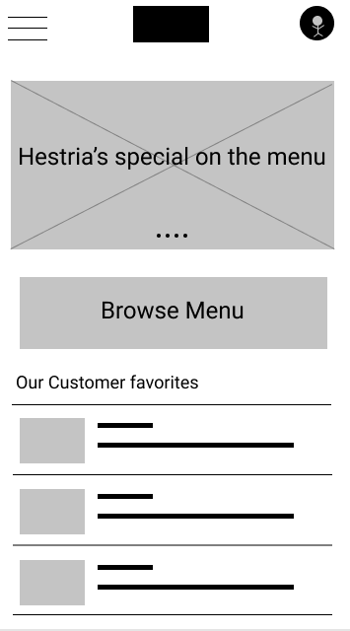
Prototype Tested
The low-fidelity app prototype for Hestria’s Kitchen was tested and can be viewed here.

Slide 7
Themes

Slide 8
People want to order quickly
Supporting evidence from the usability study.
5 out of 7 total participants said they wanted to order their their food in under five minutes
4 out of 7 total participants expressed a desire to save orders for easy re-ordering
“I like the profile feature, but it’s strange that there’s no way to store my order so I can order it again next time.”
— Mike, consumer from Brooklyn, NYC

Slide 9
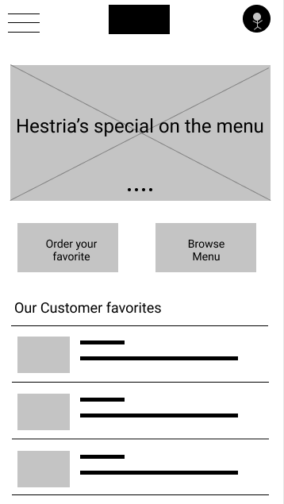
INSIGHT 1: People want to order quickly
Before
After

Slide 10
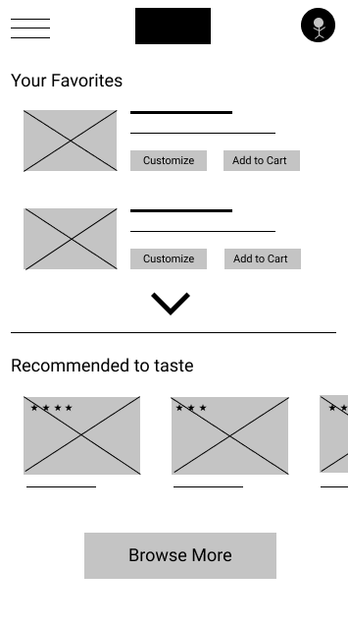
People want Access Cart quickly
Supporting evidence from the usability study.
4 out of 7 total participants said they wanted the ability to choose crust for pizza and bun for burger and sauce in addition to toppings
3 of those participants noted that they would like an option for gluten-free or low-calorie options.
“I’m gluten-intolerant, so I would really like the option to customize my pizza/bruger that meets my dietary needs.”
— Clare, consumer from Queens, NYC
a

Slide 11
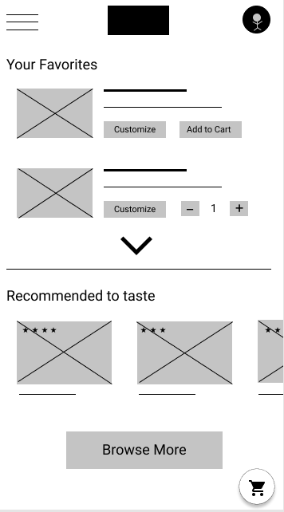
INSIGHT 2: People want Access Cart quickly
Before
After

Slide 12
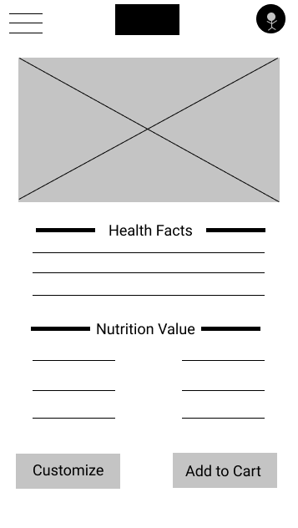
People want to view items already added
Supporting evidence from the usability study.
6 out of 7 total participants said they wanted an option for delivery and scheduled delivery
“With my busy schedule it’s not always easy to drive to the store and back. Sometimes I just want to kick back, relax, and get some food delivered as schedule. Easy.”
— Lara, consumer from Ranch, Bronx
a

Slide 13
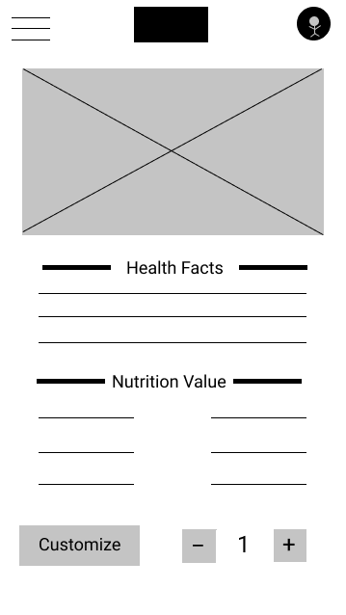
INSIGHT 3: People want to view items already added
Before
After

Slide 14
Insights & Recommendations

Slide 15
Research insights
Fast ordering
Customization options
Delivery Schedule option
Users need a way to order more quickly without having to go through the full “Customization” process..
Users need better customization options when building their own burger / pizza / pasta or any italian food.
Users need a way to order food prior lunch/dinner as a scheduled delivery.

Slide 16
Recommendations
Add a “save customization” option in the user profile so users can reorder quickly.
Add a way for users to customize their sauce and crust so they have expanded options for their dietary needs and preferences.
Add a scheduled delivery option in the checkout process so users can order from the comfort of their home.

Slide 17
Thank you!

